Slide 1

Stock market prediction
Radu Galan, ICA, 256
Ligia Novacean, ICA, 256
Daniela Stircu, SE, 248
Notes:
Myself, Ligia, and Daniela, are here to present to you today our application on stock market prediction.

Slide 2
The Stock market is the story of CYCLES and of the HUMAN BEHAVIOR that is responsible for overreactions in both directions.
- Seth klarman
Notes:
I would like to start with A quote from a really rich investor that I think really emphasize something important.
When you re trying to predict the stock market price you are actually trying to predict..
Human behavior!! More exactly crowd behavior.
This is more cyclical and repetitive than most people believe. At least that s how psychological studies and social experiments put it.

Slide 3

The problem
Investing is become more accessible for any non-specialized individual but it is not getting less difficult.
Notes:
We live in flourishing times. More people than ever are in a situation that allows them to gather economies due to the prosperous conditions.
Internet provides an incredibly simple way of investing for anyone with an ID and some cash.
Most people don’t know what they are doing and many are losing money.
These are proper conditions for rich and experienced people to take advantage of the masses.

Slide 4

The solution
An assistant that can provide accurate economical predictions.
Notes:
We’re not even close to a modern Robin Hood but
By providing capable digital assistant and universal economical education
anyone responsible enough should be able to secure a bright future in a society this flourishing financialy.

Slide 5
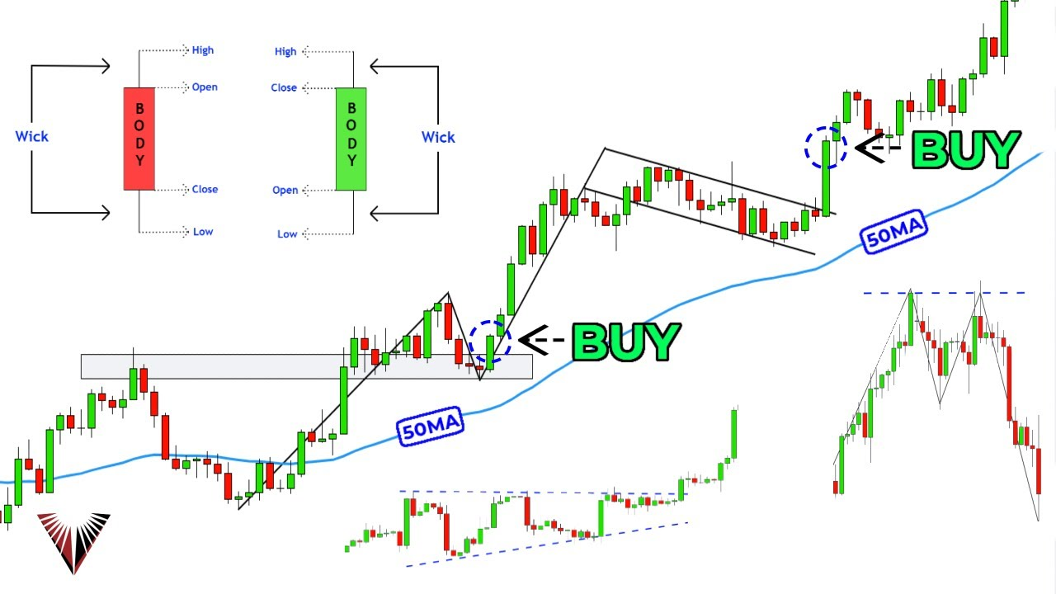
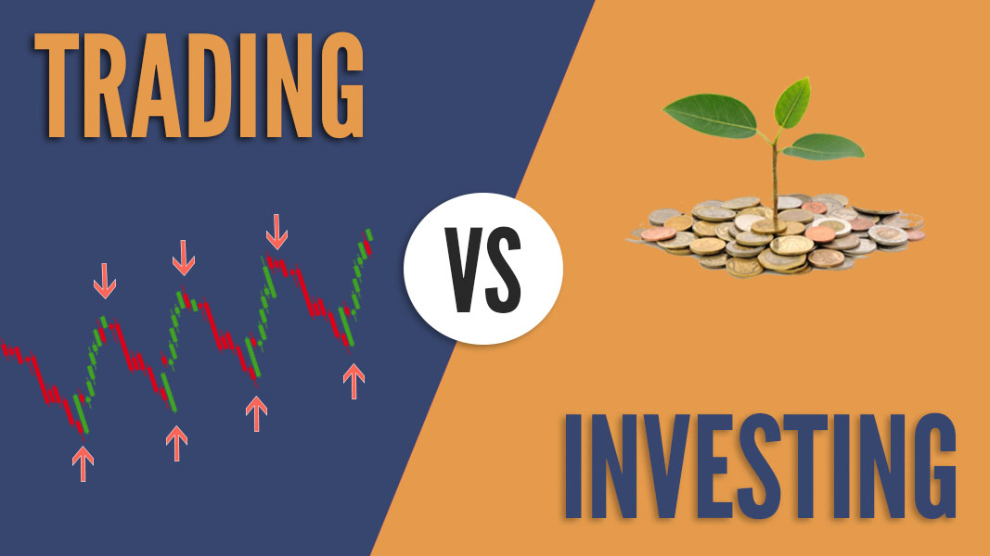
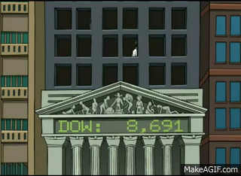
Introduction
The stock market
Trading vs Investing
Technical Analysis
Notes:
I am going to introduce through the main topics:
I think we all know what the stock market is: basically a way of becoming an investor in any listed company without being in contact with the actual company.
~
There are two main ways of making profit from these kinds of investments: investing (for long term contracts and profit through annual growth and dividends)
and trading (which means taking advantage of short and mid term opportunities and making profit from price fluctuations). We re focusing on trading
~
In trading people have tried endlessly to get rich and so multiple methods and theories have appeared. One popular theory says that the market moves in strong correlations to the news and public opinion. The media effect
Another rather complementary theory developed into methods is called technical analysis:
It is believed that the trends have meaning and there are EMERGENT properties and repetitive patterns of the human crowd investings.
We are going to rely strongly on the truthness of this fact.

Slide 6
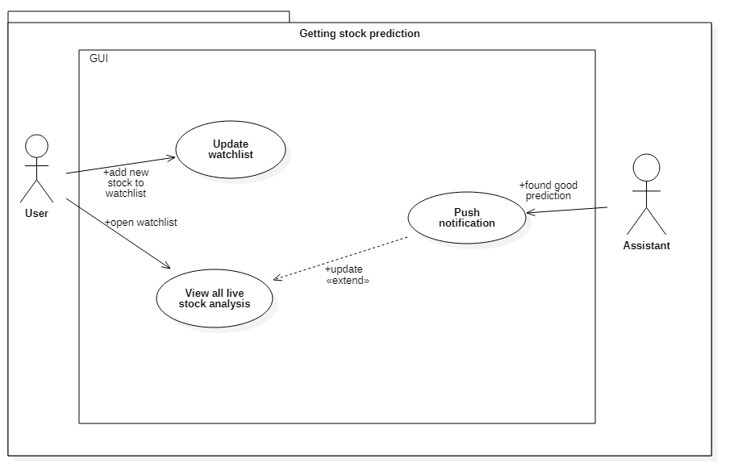
App flow
Notes:
This is the simple version of our application flow
What happens after the user enters the application is that he will be almost immediately in contact with the concept of watchlist.
The watchlist will be created to store the favourite stocks whilst optimizing the workflow. It is of course editable.
The user can select any stock and preview details, price, our analysis and predictions for that stock.
That’s all.
From this point all the user will take advantage of this information.

Slide 7
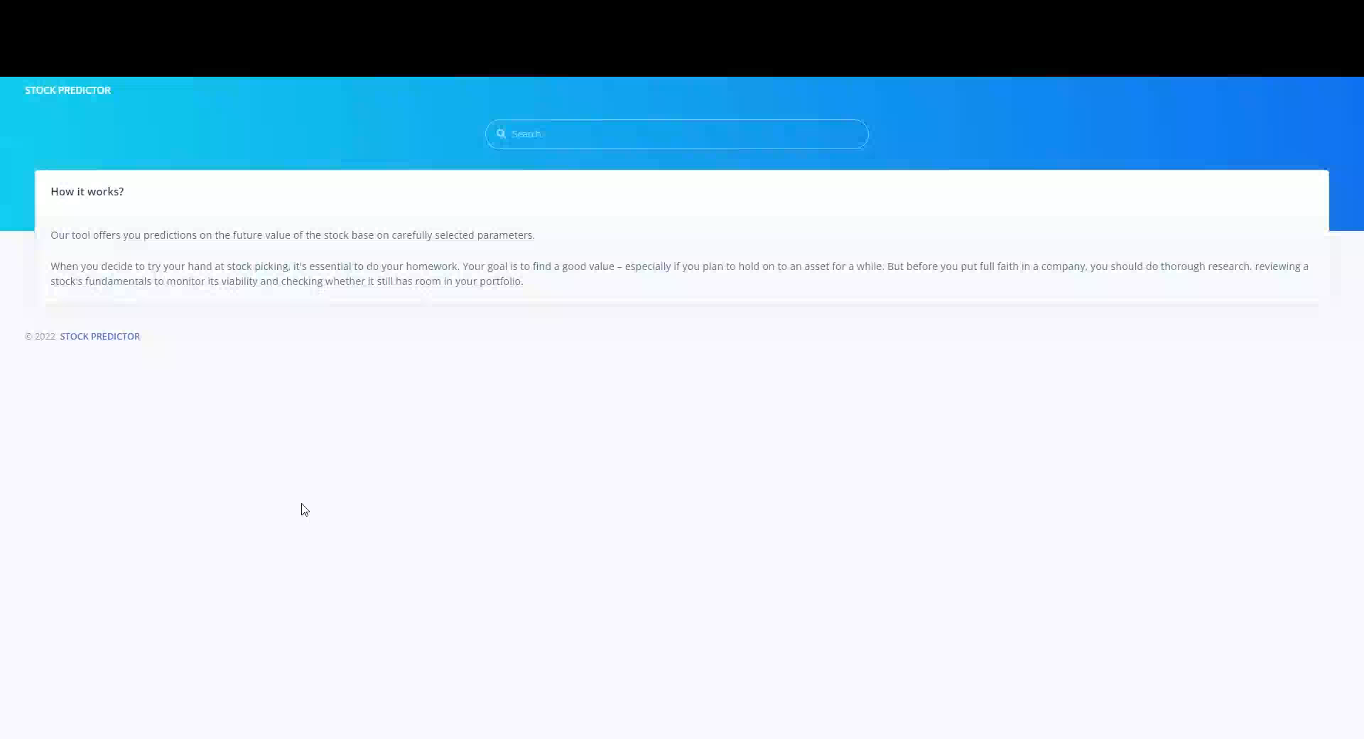
Demo
Notes:
Now you will see the materialization of the application flow into the actual product before any further explanations.

Slide 8
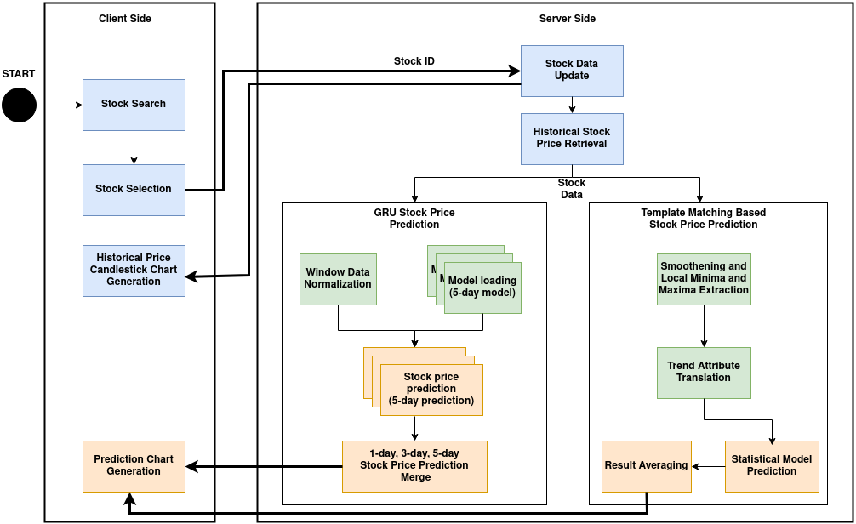
Components
Client side (Website)
Server side
Notes:
As you;ve noticed we have the client side/ the interface, which is an website
And what was less obvious is the server side that managed all the data, the processing, predictions and communications with the client side
~~
In this diagram we can observe the distribute nature of our client server architecture.
on the client side the main functionalities
and on the server sidfe the way that live data is managed and used for preditcions.
We can see how each of the methods implemented takes the data and process it individually.
There is of course a separate flow that prepares the model. The training

Slide 9
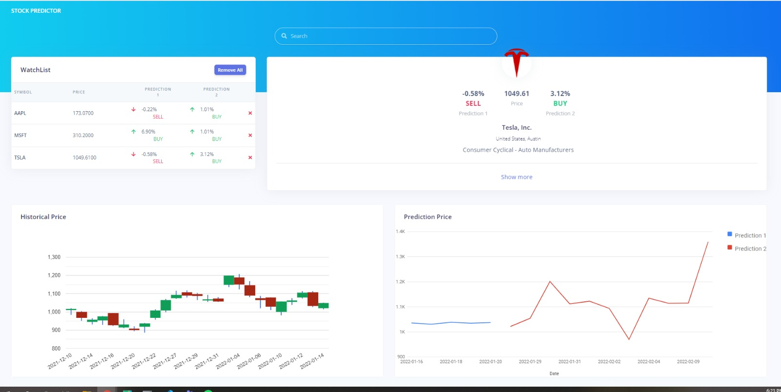
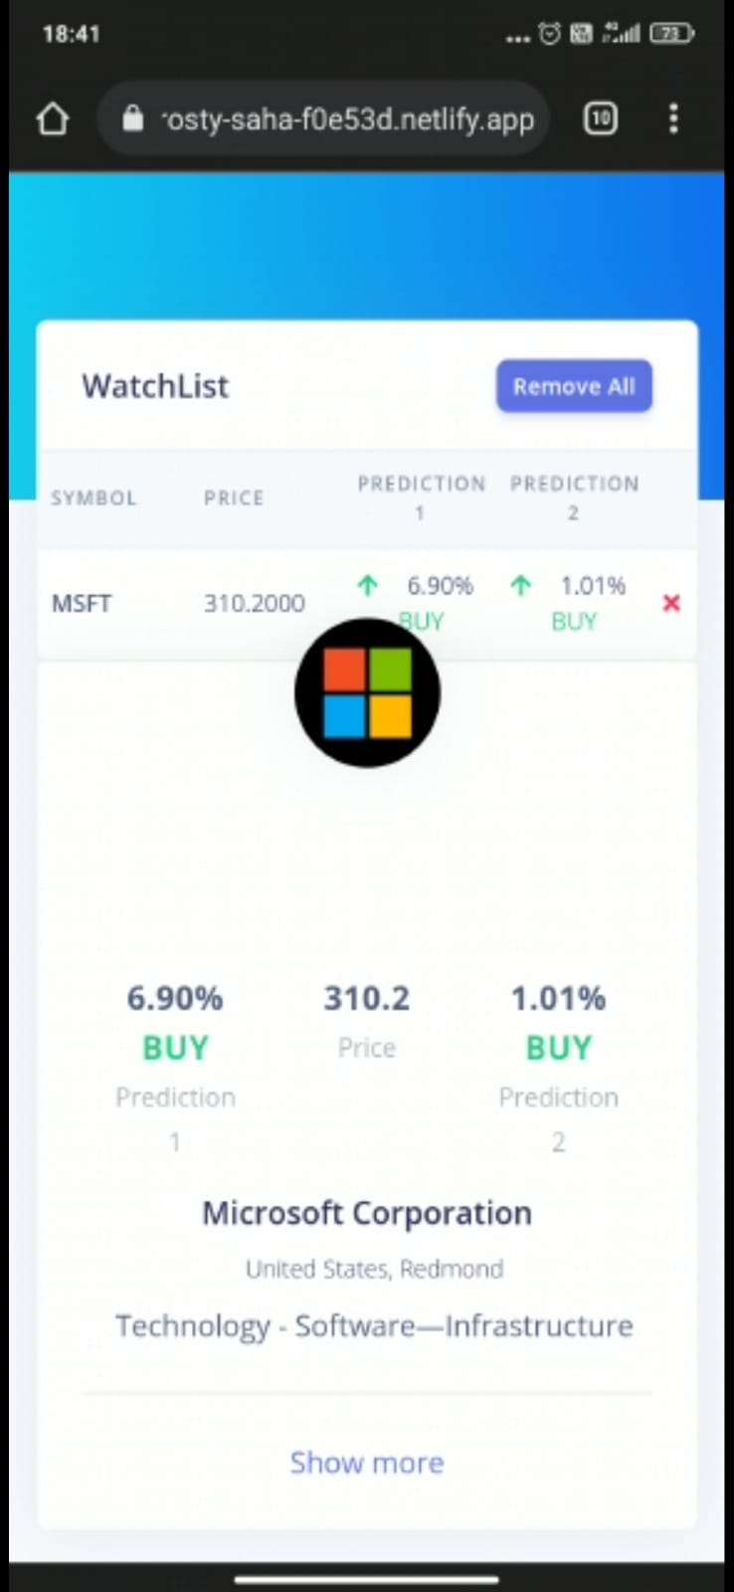
The website
Notes:
On the client side!!
The main technology stack used were HTML, CSS to style and JavaScript for behavior.
For faster transitions and a native experience we implemented a single page application and special libraries for the charts

Slide 10
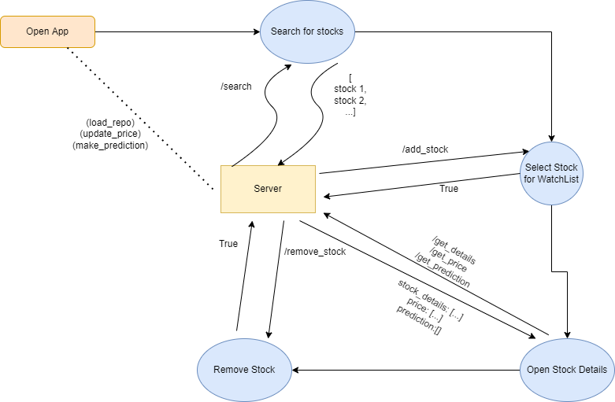

The server
/fetch_data
/update_stocks
/add_stock
/remove_stock
/get_watchlist
/search
/get_price
/get_details
/get_prediction
Notes:
On the OTHER SIDE.
The are multiple calls that are strongly related to the repository component. All implemented using flask
You can see here all the commands needed for keeping the data updated, managing the watchlist, searching for stocks by name/industry/country/etc, and requesting details of the stocks.
The predictions are made concurrently by the server when needed and not upon request.

Slide 11


The algorithms
Basic info and daily price history
30+ years
1700+ international stocks
Notes:
Both algorithms use the data provided by another component called DataGatherer.
This component has previously queried data for hundreds of stocks on general details and price history for daily prices on over 30 years.
All from yahoo finance using a python library. And saved under a .pickle format.
This data is then loaded, processed by the algorithms and the models are created.
All this happens one time only.

Slide 12
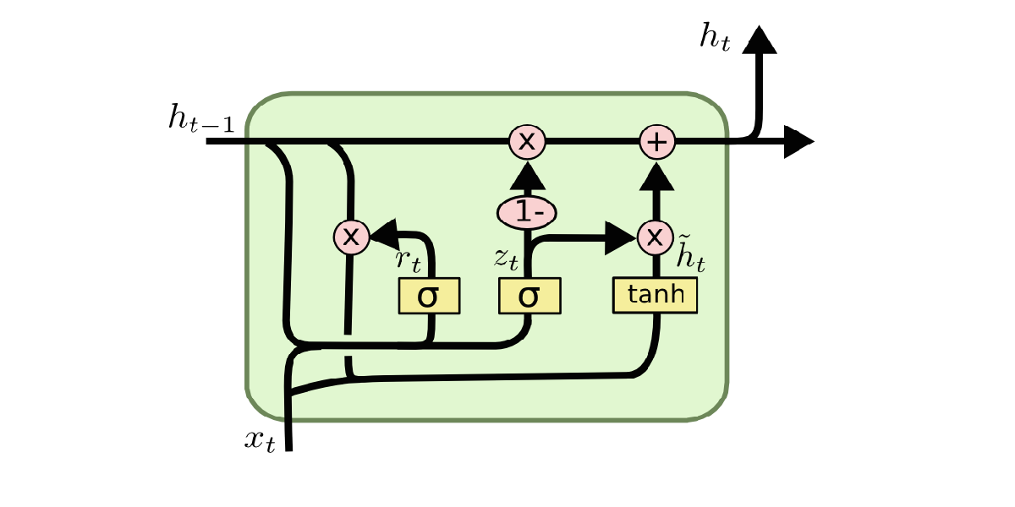
The algorithms: GRU
Recurrent Neural Network (RNN) architecture
Represents long-term dependencies
Overcomes the vanishing gradient problem using the GRU cell
Reset gate
Update gate
Notes:
For the first method we wanted to attempt to implement a state of the art learning algorithm
Traditional recurrent neural networks have a big problem with the vanishing gradient. Variations of RNNs, like GRU, address this issue with the help of memory cells. In our case, the cell is called intuitively a GRU cell. These networks can learn long term dependencies in data, so they are suitable for time series forecasting.
A GRU cell (as you can see the dissection image) contains 2 gates: the reset gate and the update gate. The reset gate is responsible for short term memory, while the update gate is responsible for long term memory. Using the reset gate, the model chooses which of the earlier steps information to discard. And then, with the update gate, it can update the current memory of the network and select the relevant inputs it needs to remember.

Slide 13
The algorithms: GRU
Global model or stock model?
Multi-step prediction?
More units or performance?
Smaller or bigger price window?
inputs: batch of windows with daily prices
output: batch of single-step and multi-step price predictions
Stock model and Semi-global model
Variable parameters, multiple models
Notes:
There were multiple questions to be answered for the specificalities
Do we need individual models for every stock or can we train a global model that learns valid patterns for all stocks?
How does the network perform for multi-step prediction?
What is the impact of the number of hidden units on the prediction performance?
Does a larger past window size result in better performance?
~~~~
inputs: mini-batch of sliding windows with daily close, open, high, low prices
output: mini-batch of close price predictions
We train models for both individual stocks and 100 aggregated stocks
We vary the size of the past stock data window, the size of the prediction, the number of hidden units

Slide 14
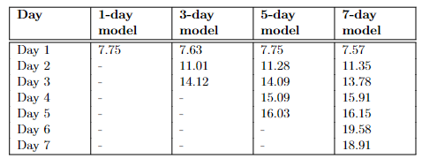
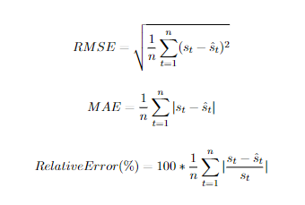
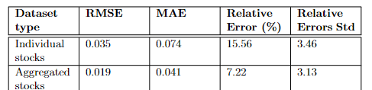
The algorithms: GRU
Root mean squared error
Mean absolute error
Relative Error (%)
Notes:
We used multiple metrics to quantify this method and the results were decent but not too good.
In the upper corner we have performance for each day prediction iusing relative error.
An below we have the statistics for the ensembled learning

Slide 15
The algorithms: Pattern Matching
Notes:
With the second method we went in a little different direction and improvise a little.

Slide 16
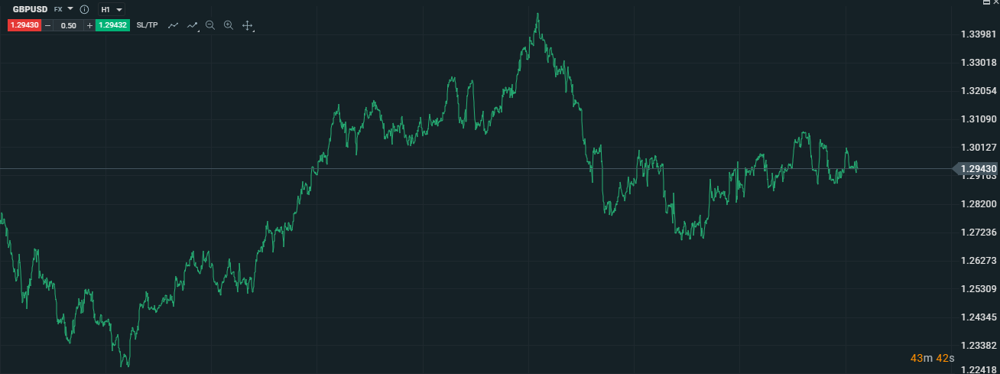
The algorithms: Pattern Matching
Notes:
I am going to explain the algorithm through an example.
It is the simplest way due to its stochastic nature

Slide 17
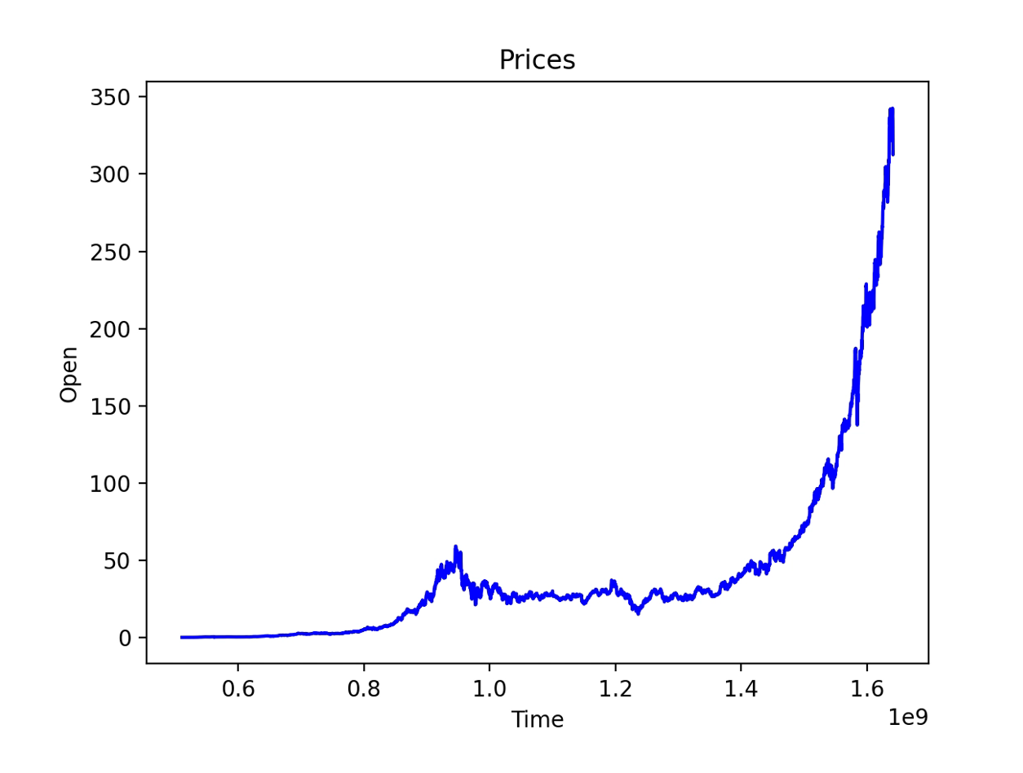
The algorithms: Pattern Matching
Notes:
We must first identify the local minimum and maxima on the graph
In the video on the corner we can see how the smoothening operation help in detection less or more points of min or max

Slide 18
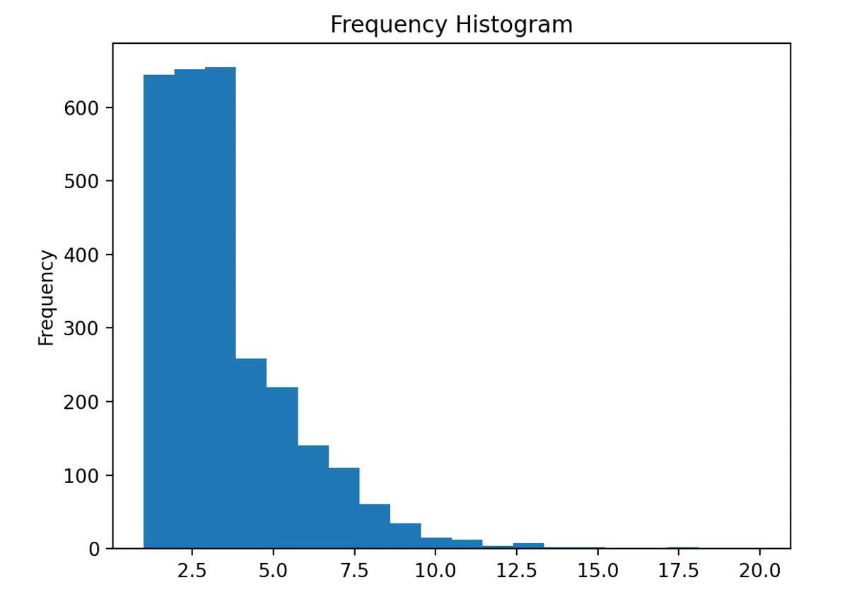
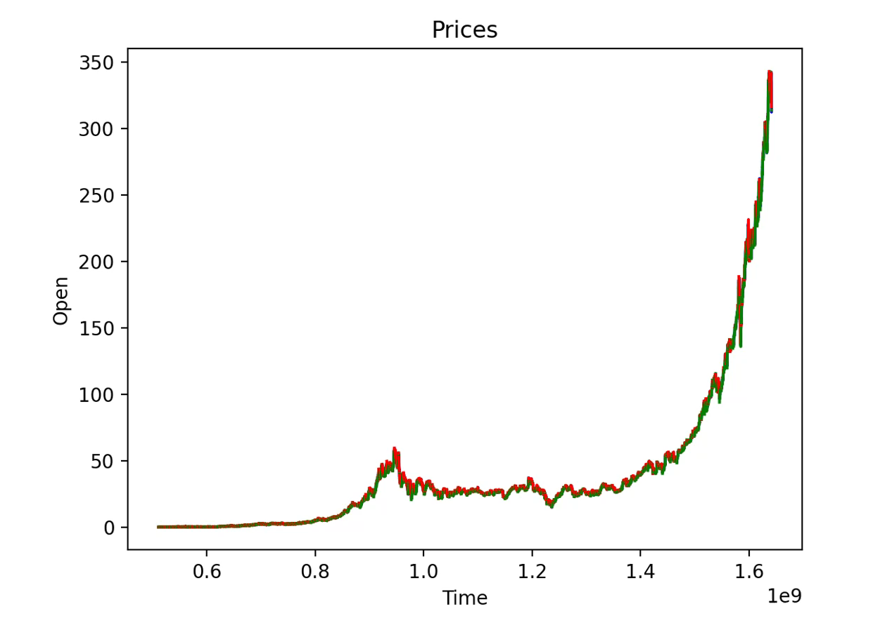
The algorithms: Pattern Matching
Notes:
Then we need to extract the price components based on those local mins and maxes.
In the graphics we can see how the smoothen factor affects again the trends and their length distribution

Slide 19
The algorithms: Pattern Matching
deltapip: x
deltaTime: y
Variance: z
Skewness: t
Kurtosis: u
(x4,y4,z4,t4,u4)
(x3,y3,z3,t3,u3)
(x5,y5,z5,t5,u5)
(x2,y2,z2,t2,u2)
(x1,y1,z1,t1,u1)
Notes:
Now we have basic trend component but we want to extract more interesting information out of them

Slide 20
deltapip: x
deltaTime: y
Variance: z
Skewness: t
Kurtosis: u
(x3,y3,z3,t3,u3)
(x4,y4,z4,t4,u4)
(x5,y5,z5,t5,u5)
(x2,y2,z2,t2,u2)
(x1,y1,z1,t1,u1)
Notes:
We’re using the price and time changes, but also the variance skewness and kurtosis factors of the price data along that trend

Slide 21
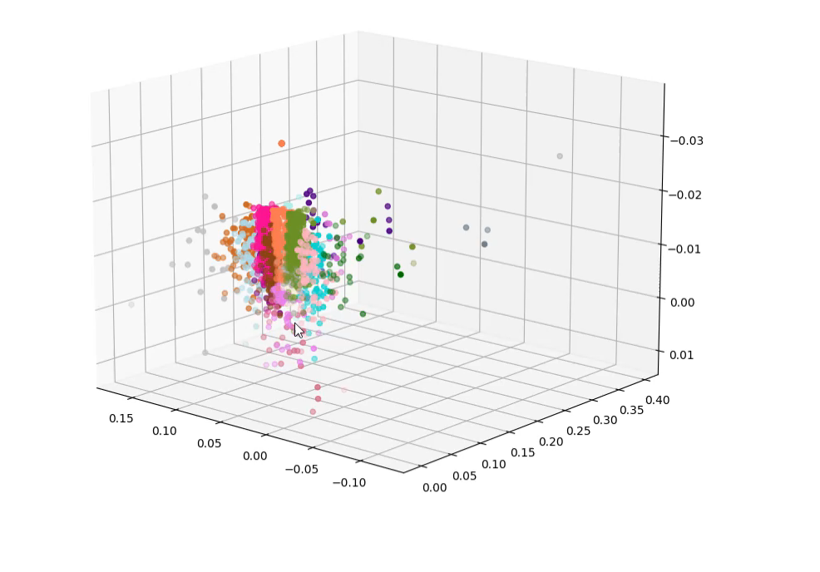
1
2
3
Notes:
Using these extracted data we will cluster the prices with emphasis on the price using Kmeans with 5-10 or 15 clusters

Slide 22
2 1 3 2 1 3 4 1 2 4...
Order
1
2
3
Notes:
We can then go back to the price history and label all trends accordingly. We will try to find patterns here

Slide 23
Order1
Order2
Order3
…
Ordern
Pattern 1 + Frecv. => Increase of 150pips, in. 650 sec
Pattern 2 + Frecv. => Increase of 250pips, in next. 430 sec
Pattern 3 + Frecv. => Decrease of 120pips, in next. 730 sec
…
Pattern n + Frecv. => Increase of x pips, in next. y sec
Pattern recognition algorithm
Notes:
By finding for each pattern the most frequent outcomes.

Slide 24
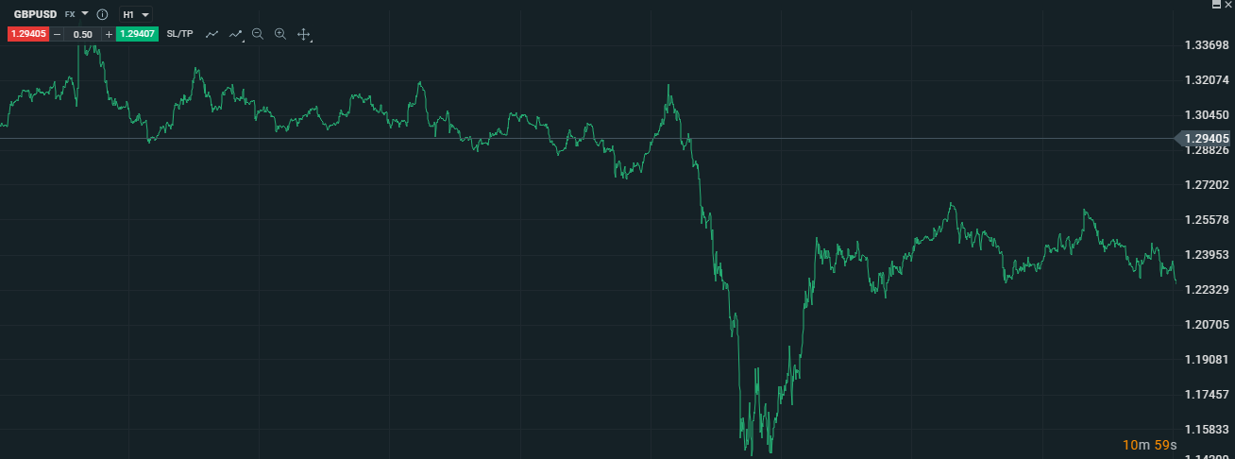
Pattern 1 + Frecv. => Increase of 150pips, in. 650 sec
Pattern 2 + Frecv. => Increase of 250pips, in next. 430 sec
Pattern 3 + Frecv. => Decrease of 120pips, in next. 730 sec
…
Pattern n + Frecv. => Increase of x pips, in next. y sec
2
1
3
4
1
Notes:
Statistically it should be rather easy to extract a probable answer from a multitude of models.

Slide 25
The algorithms: Pattern Matching
Notes:
Using a combined total of a few hundreds models with different parametrizations and accuracies we obtained and average model with relatively good results.
It is almost twice as good as a random choice.

Slide 26
User feedback
Plenty of information is available
Predictions seem really valuable
Interface is intuitive and easy to use
More filtering functionalities
More explanations regarding the predictions
Adding a certainty factor for each prediction
Option to create accounts
Notes:
We have lended the application to a few investors for their feedback

Slide 27
The inherent vice of capitalism is the unequal sharing of blessings; the inherent virtue of socialism is the equal sharing of miseries.
- Winston Churchill
Notes:
I’d hope to end on a philosophical note.
The implication of a mass adoption of a highly accurate financial models are obvious. Much like schrodingers cat… we cannot predict the future and still let it happen.
Everyone can be aware of what the best investment is but not everyone can make the best investment.
Nonetheless the increase in general financial education is still going to bring benefits on social welfare and financial stability.

Slide 28
The team
Radu Galan, ICA, 256
Ligia Novacean, ICA, 256
Daniela Stircu, SE, 248
- research, server-side, data gathering, pattern matching
- data processing, GRU algorithm, research and SOA
- research, server communication, client-side
Notes:
We organized ourselves quite decent I’d say if.. A little late
This is how we split our work and needless to say that we all contributed to the documentation and presentations.

Slide 29
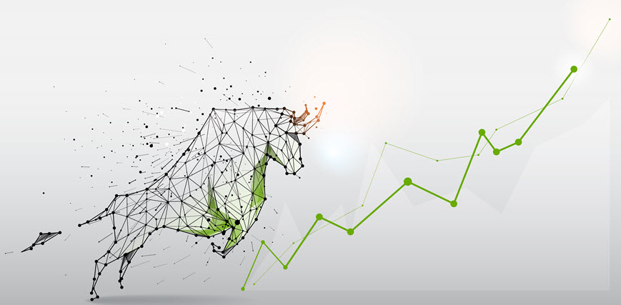
Thank you!
Notes:
Thank you and may the positive trends be with you.

